Slide 1




Heart Disease Detection
Team Members:
Dongxu Zheng (dz2353)
Shijun Zhu (sz2664)

Slide 2
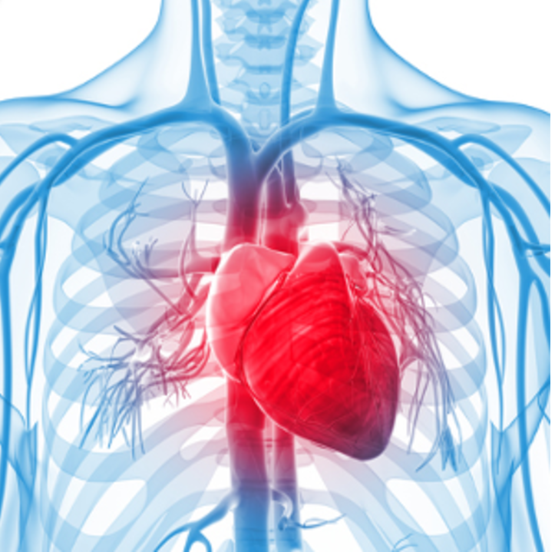
1
Introduction
Heart Disease Detection

Slide 3

Heart Disease
Some facts about
610,000
Leading cause of death
About 610,000 people die of heart disease in the United States every year–that’s 1 in every 4 deaths.
735,000
Yearly
Every year about 735,000 Americans have a heart attack. Of these, 525,000 are a first heart attack.
A heart attack occurs when the blood flow that brings oxygen to the heart muscle is blocked

Slide 4


Our Goal
Building a model to assist doctors to detect whether these patients are under a high risk of heart disease

Slide 5
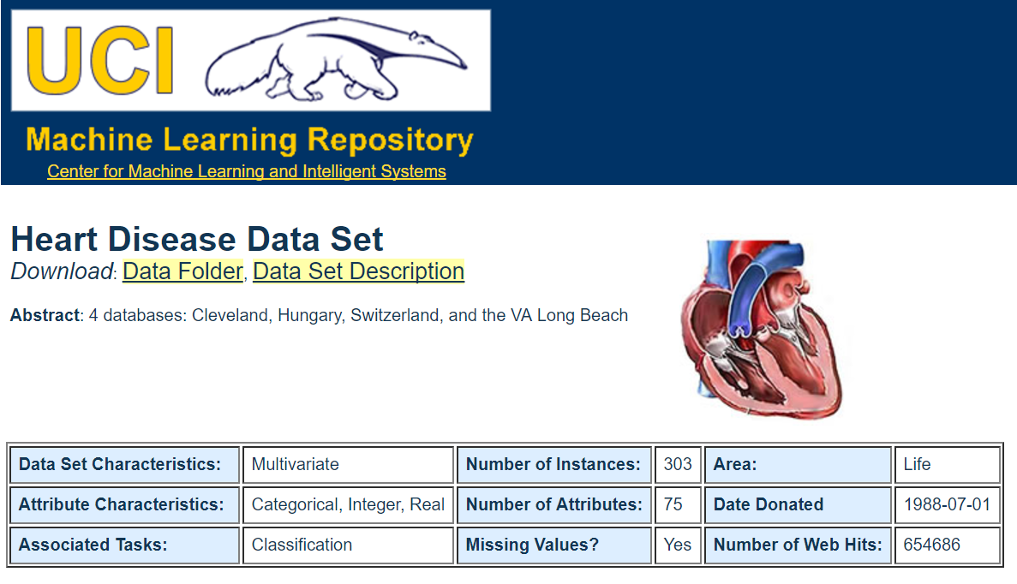
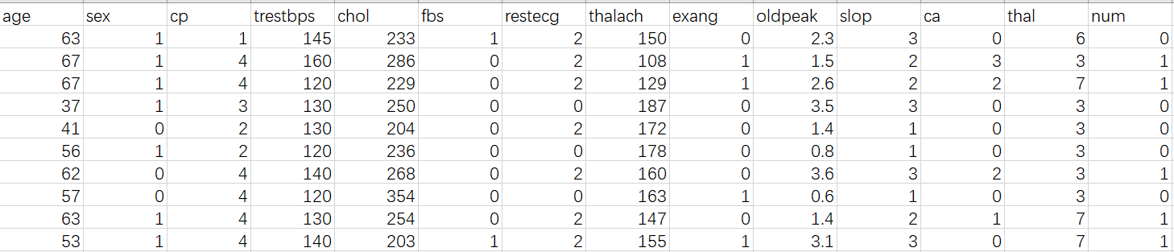
Data Set Introduction
http://archive.ics.uci.edu/ml/datasets/Heart+Disease
Cleveland database
14 attributes 303 samples

Slide 6

Project Overview
Data Pre-processing
Pickle generator
Data exploration & cleaning
Save the result of Classification
1
3
2
4
Build Model
Build website
Compare the performance of KNN; Logistic Regression; Decision Tree; Random Forest
Use flask to build our heart disease prediction website

Slide 7
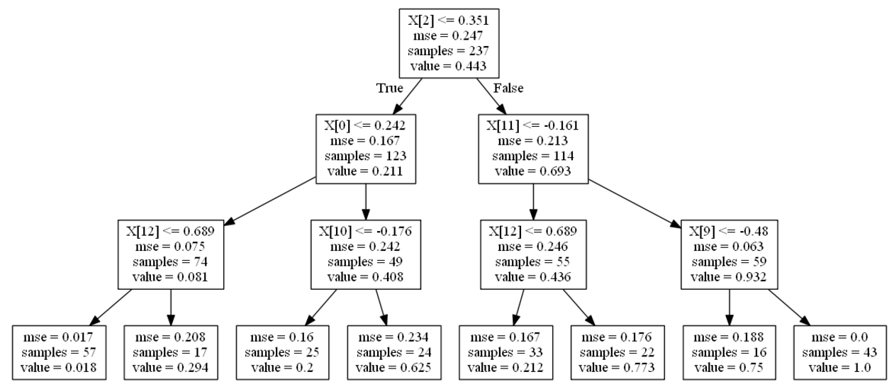
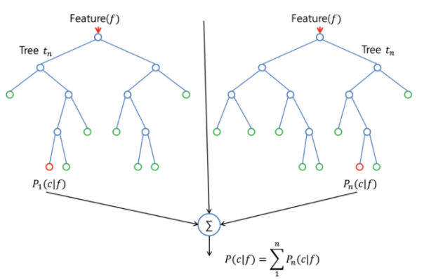
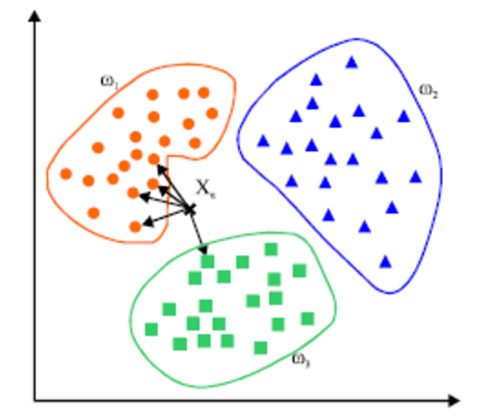
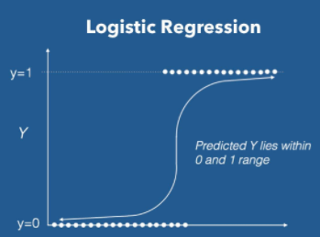
2
Building Model
Comparison of four models:
1) KNN 2) Logistic Regression
3)Decision Tree 4) Random Forest

Slide 8
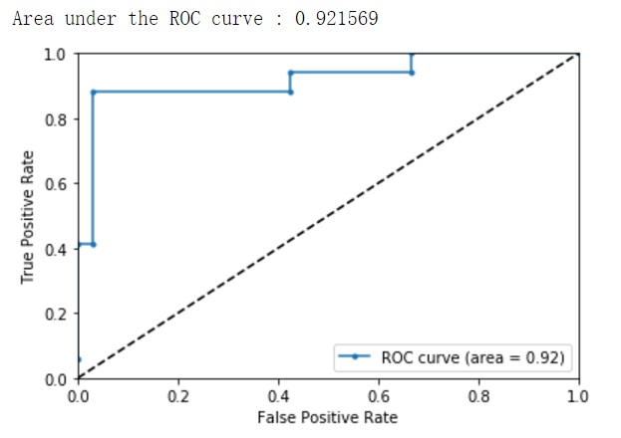
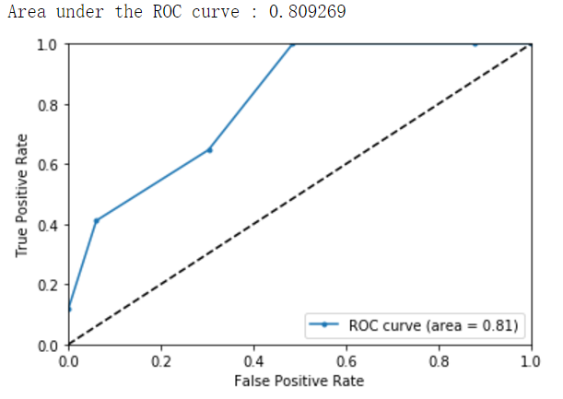
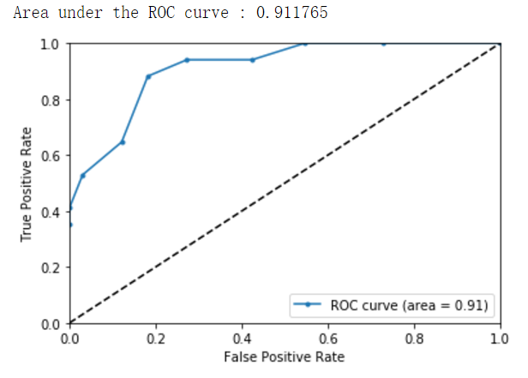
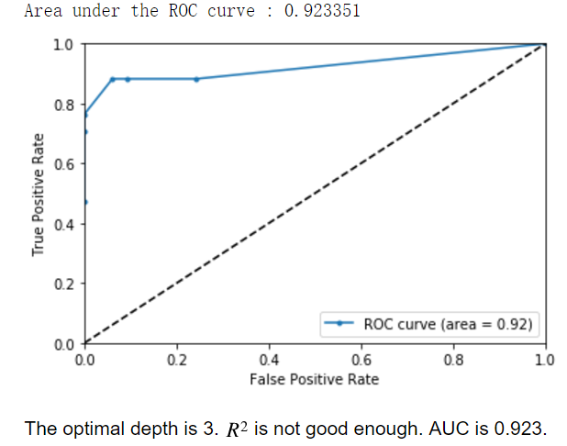
Model Selection
Choose
Logistic Regression
Based on Accuracy, ROC Curve
R^2 = 0.843
KNN Classification
Random Forest Classifier
Decision Tress
84% Accuracy
R^2 = 0.774
R^2 = 0.604

Slide 9
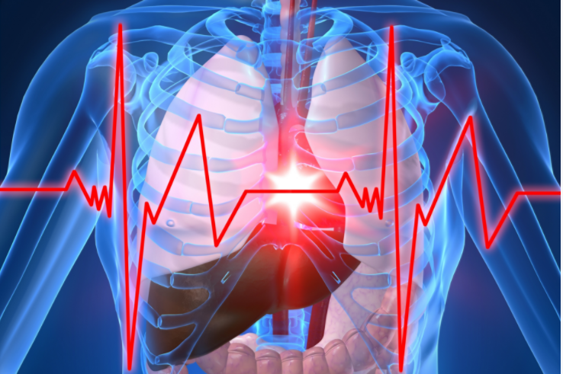
3
Website
Base on Flask

Slide 10
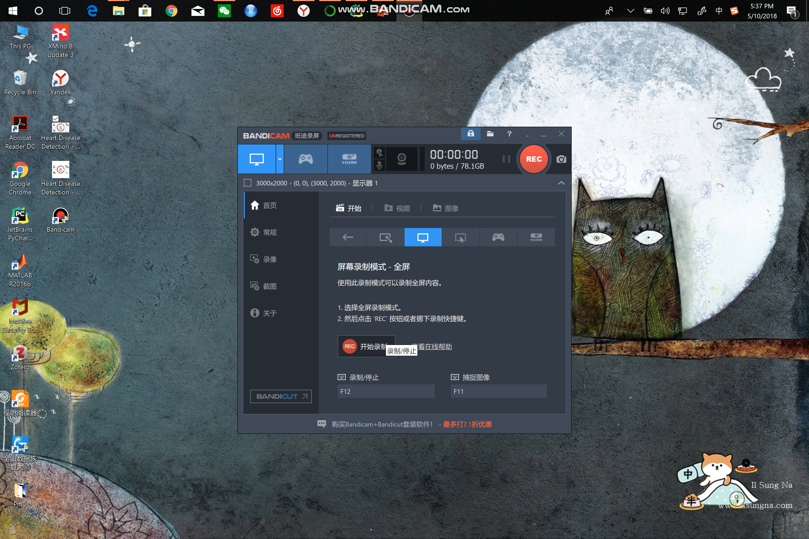
3
Website
Base on Flask

Slide 11

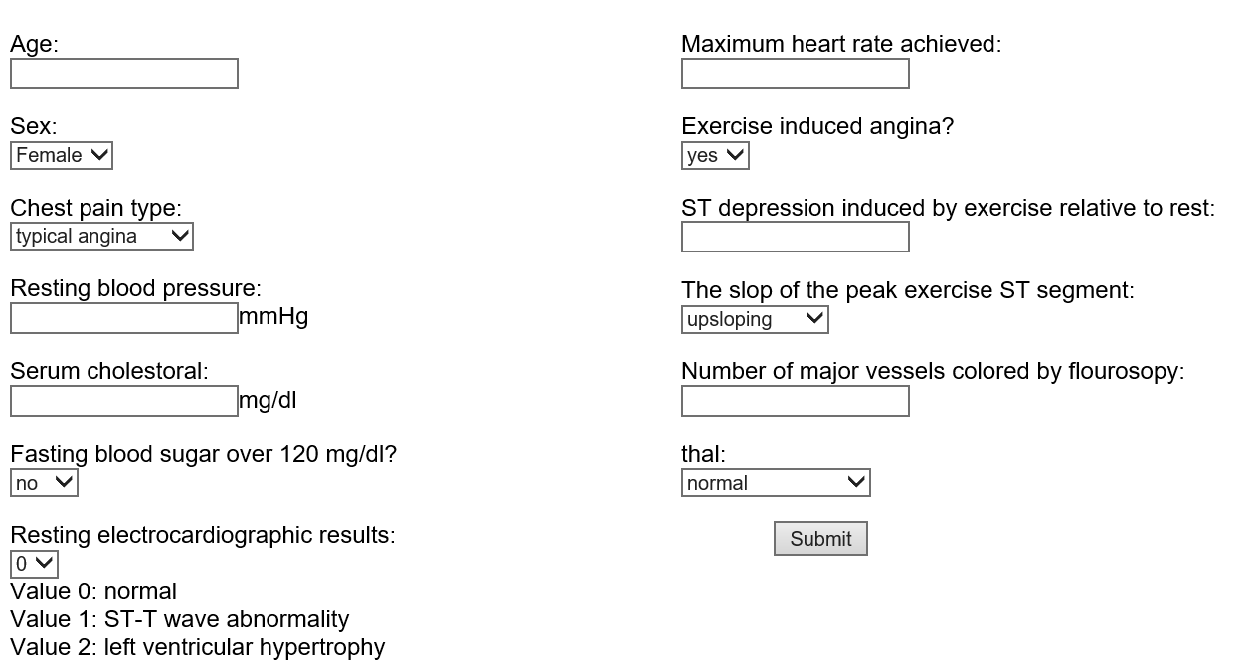
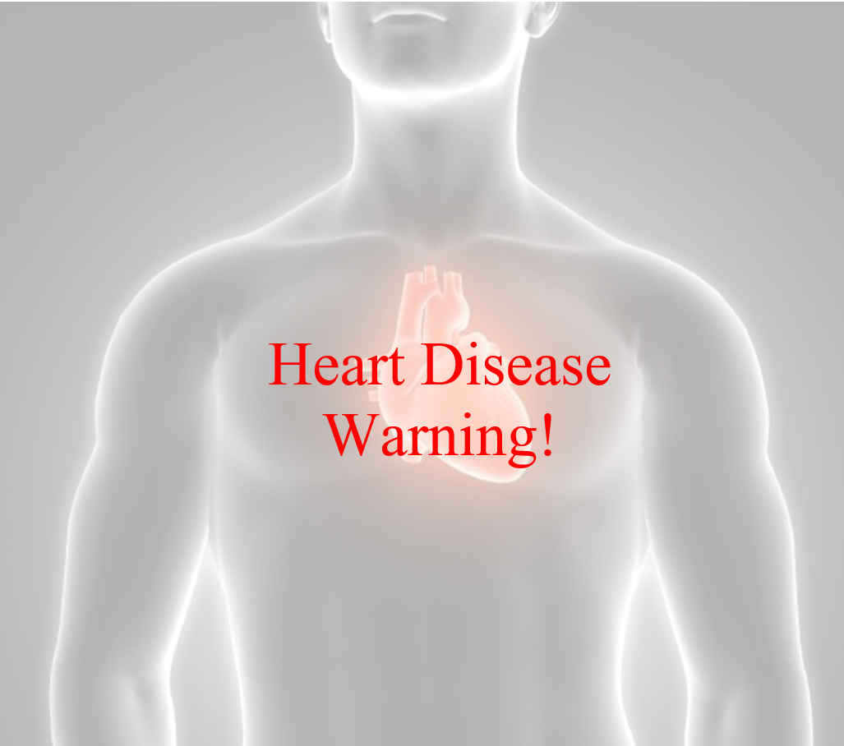
Heart Disease Detection
Interface
Website
Healthy
Warning

